Slide 1
Bank Management System
Submitted By : Submitted To :
Ashok Gupta Anudip Foundation

Slide 2
Introduction
A console-based bank management system is a software application designed to facilitate various banking operations through a text-based interface accessible via a console or terminal window. This type of system typically provides functionalities for both customers and bank staff to perform banking tasks efficiently.

Slide 3
Functionality Overview
Accountant Functions
Our Accountants are empowered to handle various administrative tasks, including registering new accountants, managing customer accounts, creating new accounts, updating existing ones, deleting accounts if needed, and viewing account details to ensure smooth bank operations.

Slide 4
Customer Functions
For customers, we've designed a user-friendly interface. They can securely log in to their accounts, check their current balance, deposit funds into their accounts, withdraw money when needed, transfer funds between their accounts or to other customers, and safely log out when their transactions are complete.

Slide 5
Account
Now, let's talk about accounts themselves. Each account in our system has a unique account number, which serves as its identifier. It also stores the current balance and the user ID associated with the account. This entity is at the core of our system, representing the financial holdings of each customer.

Slide 6
Technologies Used
Core Java: This is the backbone of our project, providing the programming logic that powers our bank management system.
MySQL: We've chosen MySQL as our database management system. It's robust, reliable, and well-suited for storing and managing the vast amounts of data typically handled by banks.
JPA (Java Persistence API): JPA simplifies the process of storing, accessing, and managing data in our Java applications. It acts as a bridge between our Java objects and the relational database.
Hibernate: Hibernate, an ORM (Object-Relational Mapping) tool, makes it easier for us to work with relational databases in Java. It abstracts away the complexities of SQL queries, allowing us to focus more on our application's logic.

Slide 7
Objectives
Our project is about making banking easier and more modern. We're creating a system that helps both customers and bank workers. For customers, we want to make things like checking their balance or sending money simpler and more convenient. For bank workers, we're making their jobs easier by automating repetitive tasks and giving them better tools to help customers. We also want to make sure everyone, no matter where they are, can access banking services easily. Overall, we're using technology to make banking better for everyone.

Slide 8
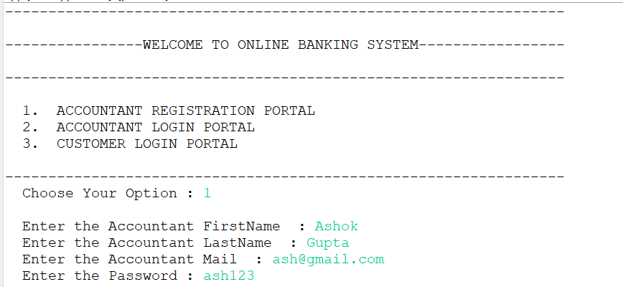
Snapshot

Slide 9
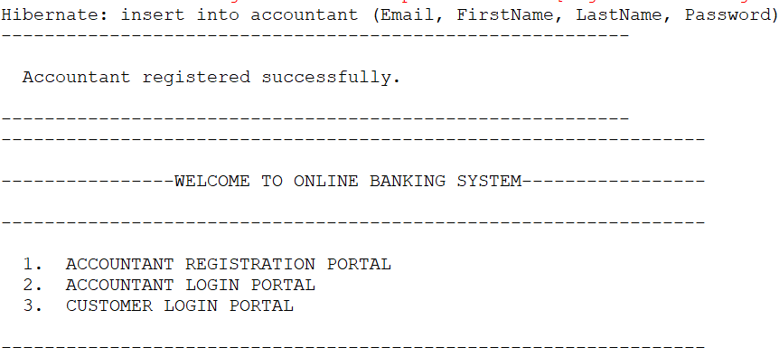

Slide 10
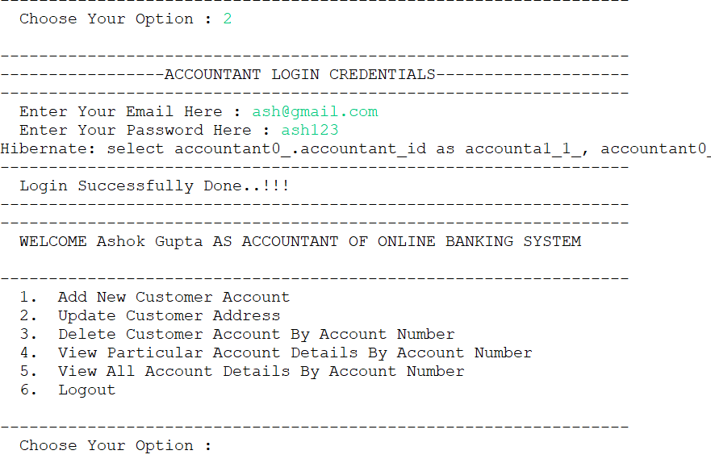

Slide 11
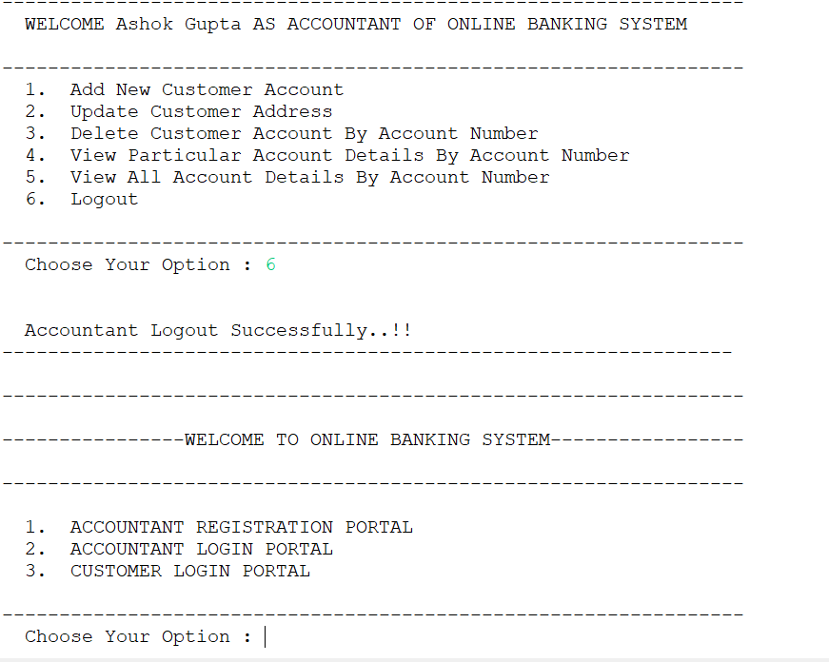

Slide 12
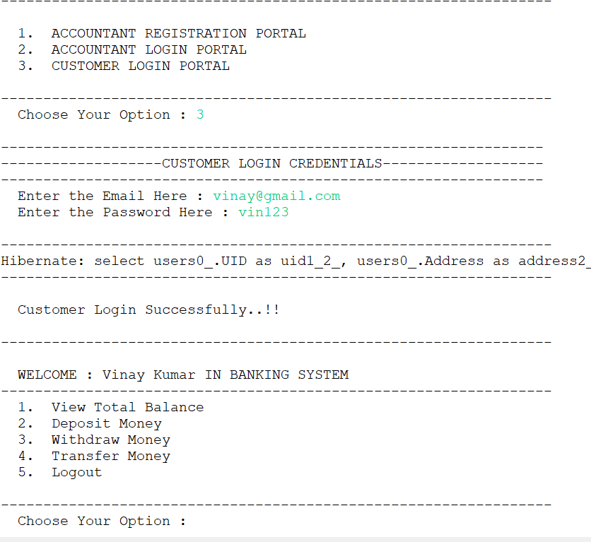

Slide 13
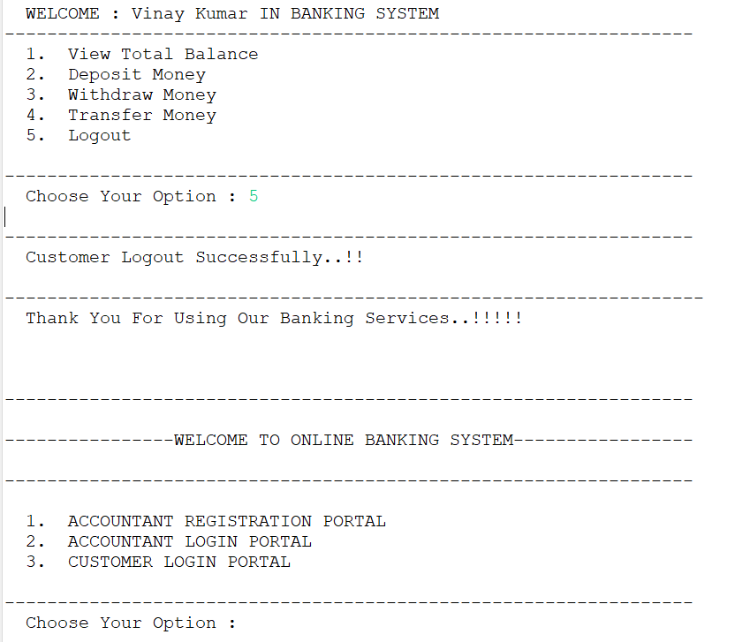

Slide 14
Conclusion
In conclusion, our console-based bank management system is a testament to our dedication to creating efficient and user-friendly solutions. We believe that by leveraging the power of Core Java, MySQL, JPA, and Hibernate, we've built a system that not only meets but exceeds the expectations of modern banking operations. Thank you for your attention.

Slide 15
Thank You !!

